Slide 1


LUGGAGE TRACKER
Jui Hemant Yinyin Prajwal Vinayaka
Notes:
Hello Prof andrie, this is Team number 12 we are here to present our product Luggage Tracker. I am Jui Ashinkar here to give you a brief overview about our product.We started developing this product from few of our team member’s personal experience. Our product is simple any passengers travelling through an airplane can locate and get the live location of their luggage. Commercial airlines carry almost more than four billion passengers and is increasing every year. Our product is for all from Students to Artists, to First time travellers to Frequent business travellers.

Slide 2
Vision
Our service Luggage Tracker provides luggage tracking for commuters at the same time collaborating with luggage manufacturing company and insurance company will help us boost the service revenue.
For Travellers, who are not sure of their luggage arriving at the destination
Our luggage tracker service provides notification to the commuters on their phone/computer regarding where the luggage is traveling real-time.
Unlike current solutions, We offer a solution based on the collaboration with the airport security team, RFID, E-Mail and GSM text message; which will be more reliable and reduce the chances of the luggage being lost.
Notes:
Losing your baggage is a nightmare. It involves lot of paper-work, there is loss of precious time, there is a panic among the travellers as they are left with no belongings, their belongings go missing or they get damaged. Any traveller who have experience such a nightmare would definitely opt for our Services but also it is not just restricted to them, everyone who are travelling and wants to know whether they and their luggage are on the same plane. For developing our services we have conducted interviews with various segments of population and have got a realistic market potential for our services. Our focus does not get restricted here it also include tie up with the Luggage Manufacturing company and Insurance company. Any customer will always prefer a bag who’s has a tracking mechanism. Using RFID technology in their bags their sales will definitely increase so it’s a win win situation. For an Insurance company with this tracking facility, Claims made by the travellers will be reduced. Hence again beneficial to both. In due course of presentation you will see about the Unmet needs,Customer segment. I request Hemant to take over

Slide 3

Unmet Needs
Reliable luggage tracking
On an average, it takes at least 3 days to recover lost luggage
Insurance companies needs!
People requirements!
Better safe than sorry!

Slide 4
Customer Segment
Travellers
Luggage Manufacturing Companies
Insurance Companies

Slide 5
Existing Solutions and why they are not good
Trakdot, LugLoc, Pluggage, Ecase
RFID
SITA and IATA approval of RFID
Cheapest Possible Rates
Complimentary Insurance Cover
Aviation Industry becomes the top promoter
Exclusive and accurate with real time tracking.
AUTO AIRPLANE MODE
BLUETOOTH
RFID
GSM
WiFi
Notes:
Hello everyone, I am Prajwal and I will be covering the Existing Solution and why they are not good enough.
Let's talk about some of the products in the market already like Trackdot, LugLoc and E-Case. One common thing you can find in their product is Bluetooth, GSM, WiFi and Auto Airplane Mode. Which means only one thing: No Real Time Tracking.
The biggest difference with our product is we are offering the RFID tags that are efficient and easy to use, they have a unique identifier and works without any network coverage. With this we are also offering a complimentary Insurance for every bag you track with our service with the cheapest possible rate.
With the upcoming vote of the International Air Transport Authority (IATA) to embrace the RFID tags for check-in proves to be a plus point to our service which will enable us to give out exclusive data and real time tracking. This will enable the customer to have a hassle-free travel and not the constant worry of losing their Luggage.

Slide 6

Use Cases
Businessman
Download luggage tracker App
Install the device to the luggage
Create an account
Link the account with the device
Tracking usage
Click “track my luggage”
Input airline number
Receive message (email or text)
“Your luggage is placed correctly”
“Oops, your luggage is wandering, please contact the crew!”
Luggage company
Install the device within the luggage
Ask the buyer to download app
Buyer creates an account
Initialize the device with account
Provide tracking service
Notes:
There are two main use cases, one is for individual user and the other one is for luggage company.
For an individual user, a businessman who has encounter lost luggage issue, bought the luggage tracker service to ensure no more that kind thing happen.
After purchase the service, he download the luggage tracker app and install the device to the luggage. Then he created an account, initialize the account with the device (each device has unique id and verification code, he just simply enter there number to the app). After these are all set. When the businessman take a flight, before he is boarding, he can click “track my luggage” on the app and input the flight number. Then he receive a message through both email and text that says either “ your luggage is placed correctly” or “ your luggage is wandering, please contact the airport staff”.
For a luggage company, they sell the luggage tracker service as a part of their product. The tracking device is installed inside of suitcase when it is manufactured. After someone bought the luggage, the luggage company staff help the customer to set up the device.

Slide 7
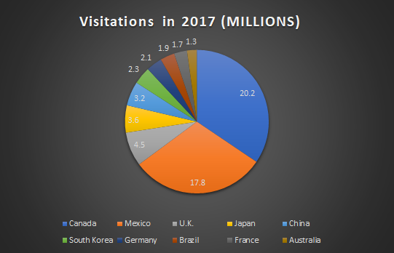
Market Size
660,000 people in the air right this instance!
4 billion trips were taken in 2018
850 million trips in USA alone!
2.6 million people fly in and out of US everyday
5.6 bags per thousands are still misplaced/lost
Huge market to tie up Insurance Companies
Lost luggage recovery cost: $2.1 billion
Notes:
Thank you YinYin. My name is Vinayak. I am going to speak about the Market size!
Did you know??!!
As we speak there are 660,000 people in the air.
Across the globe 4 billion trips were taken in 2018.

Slide 8
Risks/Dependencies
Risk in business model!
Privacy concerns?
Legal/Patent risks?
Piracy is a concern!
Interdependencies with key internal systems?
Availability of 3rd party complements?

